Slide 1
FAST Application Overview - II
R. Sathiyamoorthi
Associate Team Lead
12-June-2012

Slide 2
Topics
Query String
URL
FQID
CFID
IRPO File
DBUID
Folders2
Navigation 2

Slide 3
Topics Continue
Redirecting to Another Page
Displaying Modal Window
How to create a link in Navigation Tree
Display Navigation Link based on Activity rights
QFE & QRE Difference
MRU

Slide 4
QueryString
http://faqasna04viis11/smsfast/FastNetApp2/FileHomePageGUI/FileHomePage.aspx?FQID=HM_OE_QOD&CFID=7020554,7020320,SUD96,7019897&CBUID=189,191,1,189,191

Slide 5
URL
http://faqasna04viis11/smsfast/FastNetApp2/FileHomePageGUI/FileHomePage.aspx?
Faqasna04viis11 – IIS Server Name
smsfast – Virtual Directory or Application
FastNetApp2 – Virtual Directory or Application
FileHomePageGUI – GUI Project Folder
FileHomePage.aspx – Page which we are going to load in View Frame Area.
? – To append the Query String
IIS ServerName contains IIS then FAST application will display File Side. If IIS Servername contains ADM then FAST application will display Admin side

Slide 6
FQID
FQID=HM_OE_QOD
HM – Home
OE – Order Entry
QOD – File Home Page
function HomeFolder(){
this._sName = "Home";
this._BsID = "HM";
this._sPageURL = "../Navigation2/HomePage2.htm";
}
oChildren.add(-1, "OE", new OrderEntryFolder());
oChildren.add(-1, "QOD", new aFolder("File Homepage", "../FileHomePageGUI/FileHomePage.aspx"));
Notes:
Folders2\OrderEntryFolders.js

Slide 7
CFID
CFID=7020554,7020320,SUD96,7019897
OrderID (Customer Order ID)
FileID ( ServiceFile Table)
File Number ( ServiceFile Table)
TitleEscrowInfoID (TitleEscrowInfo)
select * from customerorder where OrderID = 7020554
select * from servicefile where fileid = 7020320
select * from servicefile where filenum like 'SUD96'
select * from titleescrowinfo where titleescrowinfoid = 7019897
select * from ServiceFileTitleEscrowXref where FileID = 7020320 and TitleEscrowInfoID = 7019897

Slide 8
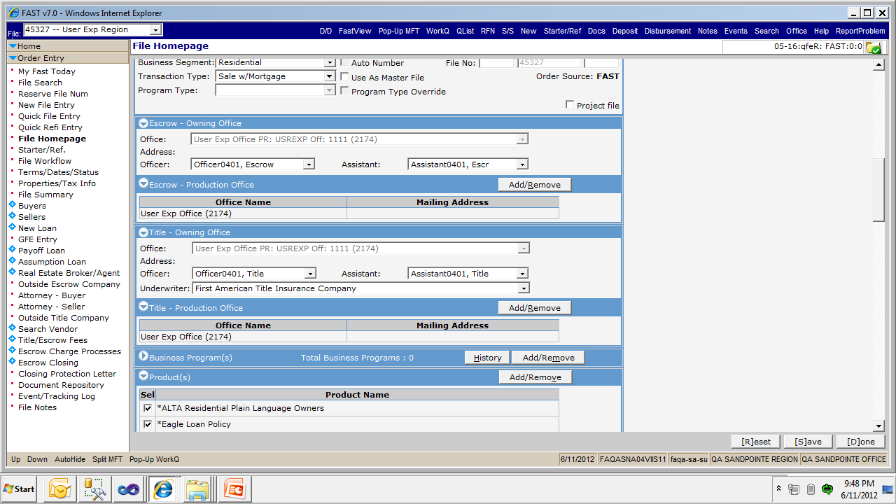
IRPO File
RFN, QFE, QRE, NFE – Logged In Region & Logged In Office
Other Links will work – Owning Region & Owning Office

Slide 9
CBUID
http://faqasna04viis11/smsfast/FastNetApp2/FileHomePageGUI/FileHomePage.aspx?FQID=HM_OE_QOD&CFID=6781903,6781670,45327,6781289&CBUID=2173,2174,1,189,191
CBUID=2173,2174,1,189,191
File Owning Region ID
File Owning Office ID
Logged In User ID
Logged In Region ID
Logged In Office ID

Slide 10
Folders2
oChildren.add(-1, "BP1", new aFolder("Maintain Corporate Business Programs", "../BusinessProgramGUI/MaintainBusinessPrograms.aspx?"));
if (bFileExists)
oChildren.add(-1, "BP2", new aFolder("Corporate Business Programs", "../BusinessProgramGUI/MaintainBusinessPrograms.aspx?"));
If (!bPendingFile)
oChildren.add(-1, "BP2", new aFolder(“Business Programs", "../BusinessProgramGUI/MaintainBusinessPrograms.aspx?"));

Slide 11
Navigation2
FrameTitle
FrameTop
ViewBottom
FrameLeft
ViewTop
MRUServiceFile.js
Security.js
SecurityKeys.js

Slide 12
Redirecting to Another Page
document.FAFContext.showAbsolute("HM_OE_QOD", '../FileHomePageGUI/FileHomePage.aspx?');
HM – Home
OE – Order Entry
QOD – File Home Page
document.FAFContext.showAbsolute("HM_OE_QOA,0", '../FileHomePageGUI/OrderInfoForm.aspx?NewOrder=0&NewRefiOrder=1');
QOA – Quick File Entry
If NewRefiOrder = 1 means we are loading Quick Refi Entry Screen otherwise we are loading Quick File Entry Screen

Slide 13
Displaying Modal Window
var sFeatures = "dialogHeight:550px;dialogWidth:800px;location=middle; menubar=no; status=no; toolbar=no; scrollbars=yes; resizable=yes";
var queryStr = lblQueryStr.innerHTML;
var sURL = "FileInfoFrame.aspx?" + queryStr;
var sRet = window.showModalDialog(sURL, "FileInfo", sFeatures);
var sFeatures= "Height: 600px; Width: 800px;" + "center:yes; help:yes; status:no; resizable:no; scroll:no; titlebar:no";
var args = new Array();
args[0] = document.Form1.hidOrderID.value;
var qs = "?hdMultiPageSessionTaskEdit=" + document.Form1.hdMultiPageSessionTaskEdit.value;
var urlVar = "../WorkFlowGUI/WFEditWorkFlow.aspx"+qs;
var arrReturnArray=FAFShowModalChild(0,"Edit Task",urlVar, args, sFeatures);

Slide 14
QFE & QRE Difference
Quick File Entry | Quick Refi Entery
Using FileHomepageGUI\OrderInfoForm.aspx | Using FileHomepageGUI\OrderInfoForm.aspx
New Lender Business Party | PayOff Lender Business Party
Buyers, Sellers section available | Borrowers, Sellers section available
All Transaction Types | Transaction Type has only Refinance, Mortgage Modification, Construction Disbursement

Slide 15
MRU
document.FAFContext.LegacyNav.currFile.set(arr[0], arr[1], arr[2], arr[3], arr[4], true, arr[8], arr[7], arr[5], arr[6]);
//document.nav.currFile.set(arr[0], arr[1], arr[2], arr[3], arr[4], true, arr[8], arr[7], arr[5], arr[6]);
Refer function setMRU(strParam, strButton) method on FileHomePageGUI\OrderInfoForm.js file for more detail

Slide 16
Thank You
sarajamanickam@firstam.com

